Slide 1
Bosch dishwashers: models and reviews analysis
Dario Savaresi,
AIDA for Business Master, University of Milan – Bicocca, July 2026

Slide 2




Motivations
R&D
Marketing & Product Line
From a technical standpoint, BSH group represents the state of the art concerning dishwashers, with its European brands: Bosch, Siemens, and Gaggenau.
R&Ds from all competitors study Bosch dishwashers: technology, cycles, ergonomy, …
Quality of Bosch appliances is recognized by the most important consumer magazines in Europe:
BSH marketing strategy and customers’ perception is harder to be studied.
Commissioning studies from external companies is costly, limited in scope, and introduces an unavoidable delay between the date the study is commissioned and the actual delivery of the results.
Info retrievable from the website is a source of information not adequately exploited.

Slide 3
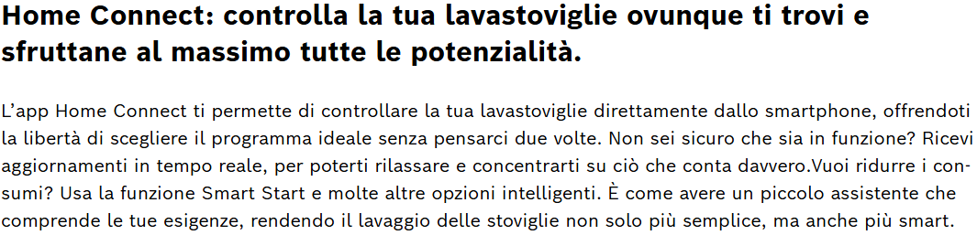
Scenario & Questions
Scenario
Business Questions
Bosch exposes its dishwasher catalogue with multi-language reviews on its italian website.
Within each dishwasher page, associated claims are shown.
Characteristics associated to each appliance can be retrieved from HTML pages. Reviews are downloaded thanks to GraphQL APIs.
The goal is to develop a queryable data warehouse containing products and customer reviews.
What does the typical Bosch customer look like?
How customer satisfaction varies across countries?
Which are the most sold products? Which are the products with highest reviews?
Do claim have an influence on reviews and star rating?

Slide 4
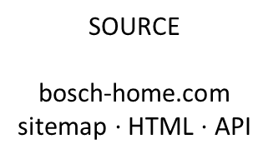
ETL architecture
SOURCE
bosch-home.com
sitemap $⋅$ HTML $⋅$ API
EXTRACT
scraping phase: models, reviews, claim highlights, energy rating, …
TRANSFORM
data cleaning,
review translation,
boolean variables for claims
LOAD
relational DB as industiral standard
PRODUCT_DB
model, description, series, energy rating, claim
REVIEW_DB
review text, star rating, user info, date, country
ETL OUTPUT:

Slide 5
EXTRACT phase – Scraping
Models
Reviews
Sitemap scanning
Looking for all products of type dishwasher with regex: model and URL associated to each product.
GraphQL API
For each model, the API call gives a JSON back with all the reviews, not only for the selected model, but also for all the european equivalent models (this is a standard for all manufacturers).
Dishwasher model scraping
Extraction with BeautifulSoup of base information: name, energy rating, installation type, …
Information retrieval
Dictionary-like parsing of information: title, text, user info, rating, …
Claim scraping
JavaScript string decoding generated during webpage loading. Concatenation of all claims in a string claim_raw.
products.csv
reviews.csv

Slide 6
TRANSFORM phase – Products
Dishwasher filter
Filtering of all dishwasher products: e.g. removing all entries with /accessori/ in the URL.
Name cleaning
Removing spurious sub-strings in the name, e.g. those containing dishwasher model, already stored in a dedicated field.
Output: stg_products.csv
csv file with the following colums: code, name, series, install_type, energy_class, avg_rating, review_count, is_discontinued, url, claim_raw, has_*, has_*_evidence.
Claim detection
22 regex pattern to recognize claims based on claim_raw string. Creation of a boolean variable has_* for each claim.

Slide 7

TRANSFORM phase – Products
Numerical mapping
age_midpoint: ‘From 25 to 34’ $→$ 29
Household_size: ‘Couple’ $→$ 2
usage_weekly: ‘Seldom’ $→$ 0.1
Dishwasher filter
Removing reviews related to model codes not in stg_products (e.g. accessories).
Language and country
Split on locale field (e.g. it_IT), useful to extract a geographical dimension from reviews.
Output: stg_reviews
csv file with the following columns (selection): queried_product_review, date, rating_{overall, programs, loading, noise}, text, country, age_midpoint, household_size, usage_weekly.
Date parsing
From UTC format to year, month, day.
Review translation
Call to Google Translator through deep-translator library to unify revieews.

Slide 8
LOAD phase – Data Warehouse
Relational DB
Electrolux standard (e.g. with respect to document DB, like Mongo), easily querable also by people with fewer experience.
Variable selection
Only the most informative variables are stored in the the DB for the following analysis and visualization stages.

Slide 9
LOAD phase – Data Warehouse
REVIEW_DB
[PK] review_key new unique primary key
[FK] product_it link to PRODUCT_DB
year/month/day date fields
rating 1 – 5
rating_progs, … 4 secondary ratings
country 2 letter ISO standard
age_midpoint 15 – 68
household_size 1 – 4
usage_weekly 0.1 – 7
title_en/text_en review english translation
PRODUCT_DB
[PK] product_id Bosch model code
serie Series 2/4/6/8
install_type Built-in | Freestanding
energy_class A – G
avg_rating Aggregated star rating
review_count total review number
is_discontinued bool
has_aquastop, … 22 claim flag (bool)

Slide 10
Data Warehouse – some numbers
PRODUCT_DB
REVIEW_DB
141 dishwasher models:
98 active models
43 discontinued models.
Good mix of built-in and freestanding models.
Most represented energy classes: A and B.
Most represented serie: Serie 4.
15271 total reviews.
84 dishwasher model with at least one review.
Average star rating: 4.84/5.
Time span: from July 2017 to June 2026.
4230 incentivized reviews.

Slide 11
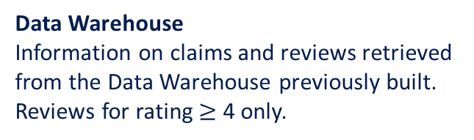
Analysis: are reviews and claims related?
APPROACH
Claim | Reviews | Mentions % | Exact %
Silent Power Drive | 14146 | 39.3 | 0.0
Home Connect | 13296 | 10.6 | 3.4
Open Assist | 304 | 8.9 | 1.3
Efficient Dry | 8782 | 6.9 | 1.0
Perfect Dry | 3385 | 5.3 | 2.2
Regex
Dictionary of regex for each claim, to understand if the reviews cite the exact claim name or some related topics.
Data Warehouse
Information on claims and reviews retrieved from the Data Warehouse previously built. Reviews for rating $≥$ 4 only.
HINT
There is no direct correlation between claims and reviews. Customers leave comments related to claims, but they rarely mention them explicitly and often do so unconsciously. While claims may influence purchasing, they do not influence the content of reviews. Home Connect is mentioned more frequently because it is the name of Bosch app.
Review and claim correlation
Percentage of reviews citing the exact claim name or some related topic.

Slide 12

Sviluppi Futuri
Data Visualization
Migrazione su cloud (AWS)
Analisi Machine Learning
Visualizzazione dei dati per l’estrazione di insight sui prodotti e le recensioni delle lavastoviglie Bosch.
S3, AWS Glue, Athena, AWS Lambda. Temporizzazione ad intervalli regolari, e.g. quindicinali, mensili.
Le informazioni ottenute abilitano modelli predittivi e di clustering. Sentiment analysis e classificazione delle recensioni.
In sviluppo su Python
https://github.com/SavarDar2204/Bosch-Reviews.git
Notes:
Roadmap: visualizzazione, cloud AWS, orchestrazione, ML. Ogni blocco è indipendente e prioritizzabile.

Slide 14
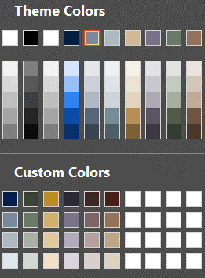
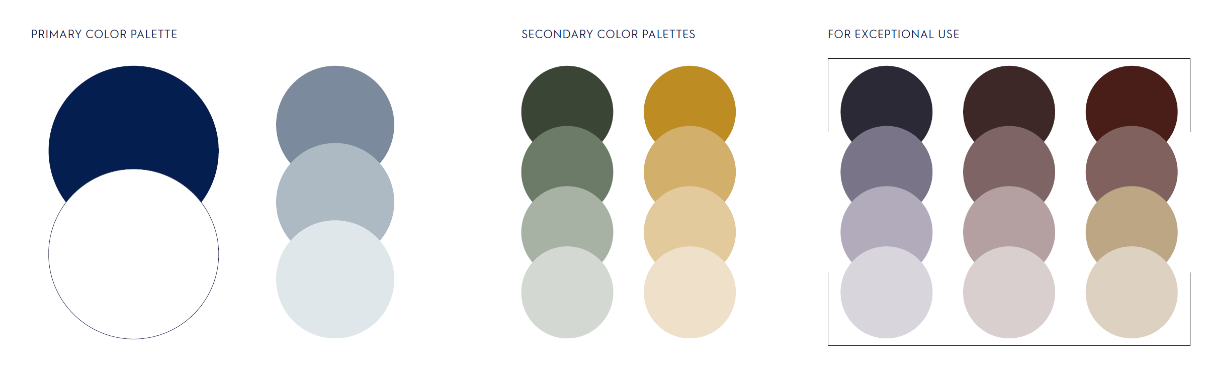
Using the Electrolux colors
The primary color palette is made up of a set of five colors: Electrolux Blue supported by neutral tones, including white.
Our secondary color palettes are designed to add further depth and flexibility to our Group brand. These palettes can be used internally where more creative license is permitted. The exceptional use color palette is indicated for intranet and internal use only.
1
2
3
4
5
6
These colors are not allowed to be used.
Colors to use:
the top row under Theme Colors
all colors under Custom Colors.

